Slide 1
Majors Department Windows Fact Tag
Instructions

Slide 2
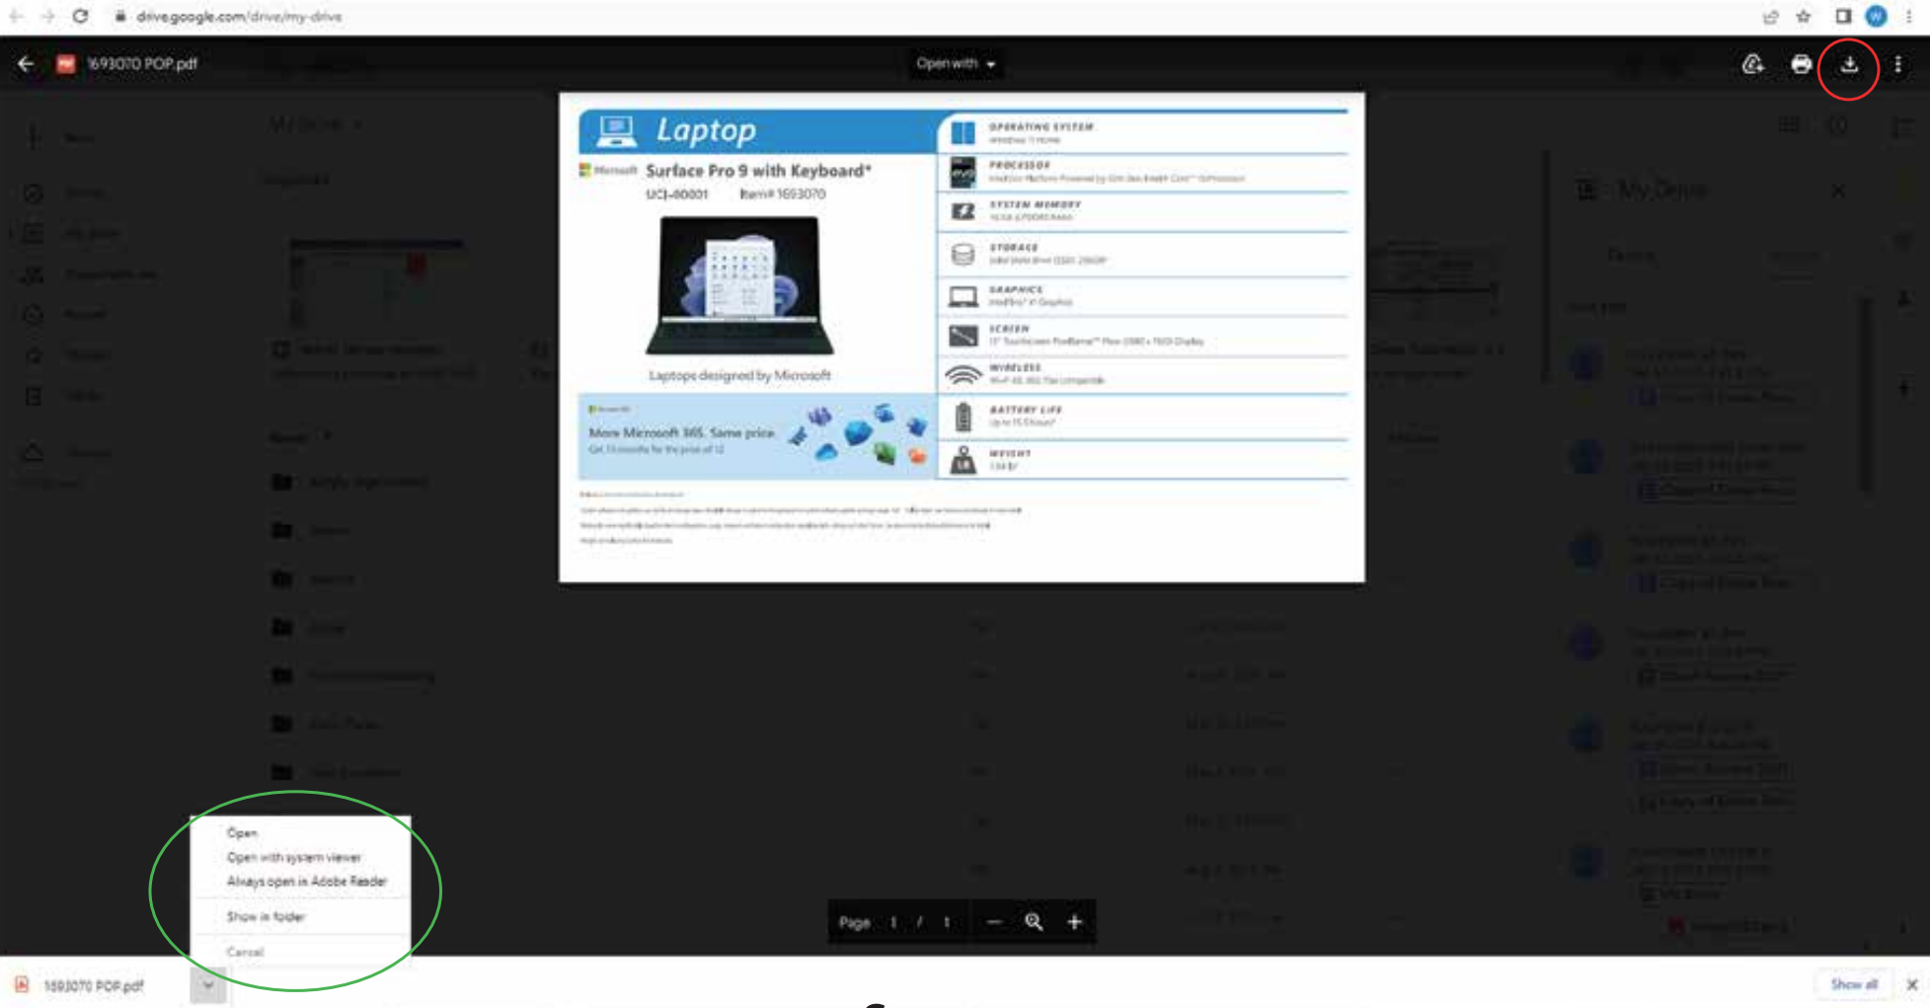
Step 1
From the Google Drive open up the corresponding device to the SKU listed in the system.
Double click on it to open the PDF view of it
In the top right corner click the download button indicated by the red circle
After the Download is initiated, a pop up will appear at the bottom of your screen, click the arrow on right of the PDF download which will bring up a list of options
Select “Always open in Adobe Reader”
Then Select “Open”

Slide 3
Step 2
When the Adobe Reader PDF opens, click on the printer icon located at the top-left corner of the screen

Slide 4
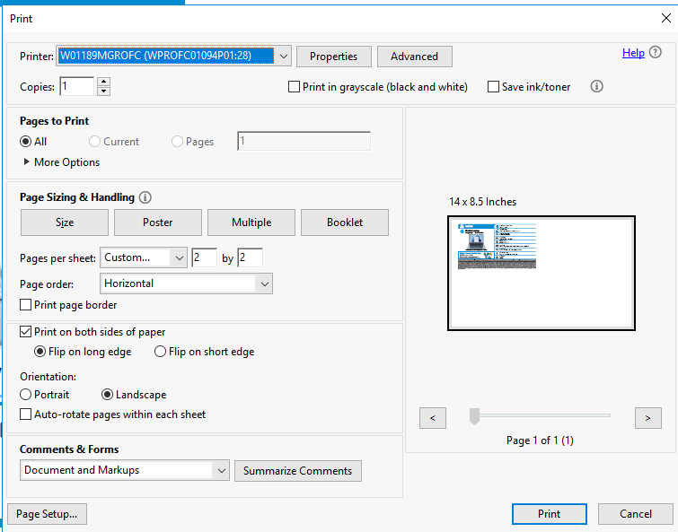
Step 2
This will print up the Print options menu

Slide 5
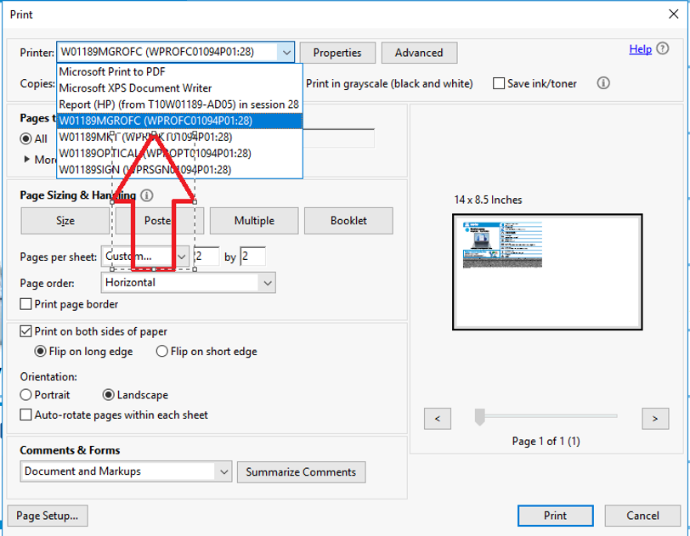
Step 3
First, click on the dropdown bar labeled “Printer” to select the Printer location.
We want to select the manager’s office printer which is usually labeled: W[warehousenumber]MGROFC

Slide 6
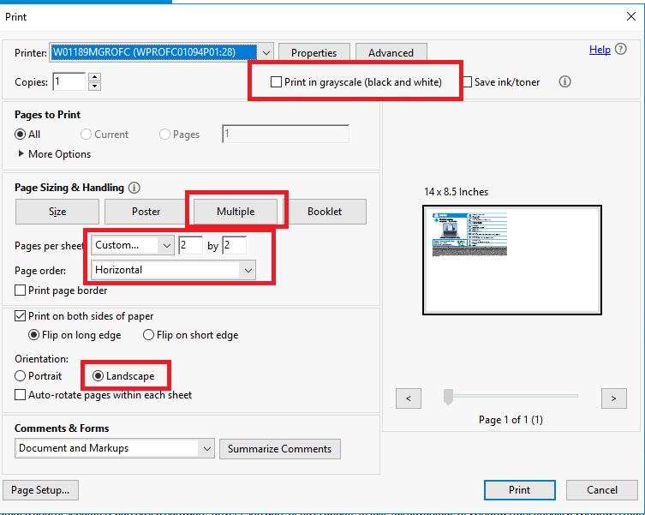
Step 4
Next we want to assure some settings to make sure nothing prints improperly.
Make sure the box for grayscale is not checked as we want to print in color
On “Page Sizing & Handling” select “Multiple.”
Set the pages per sheet to “Custom” and “2x2” for the perforated paper.
Finally assure the Orientation is set to “Landscape.”

Slide 7
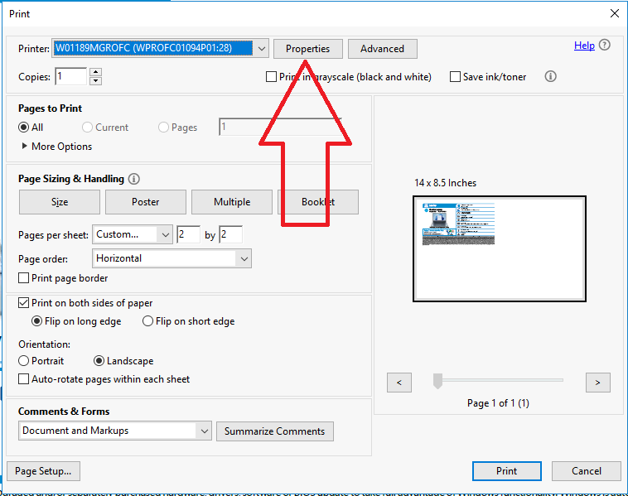
Step 5
Next we are going to click on the Properties button located at the top of the print options.
This will bring up a new pop-up window

Slide 8
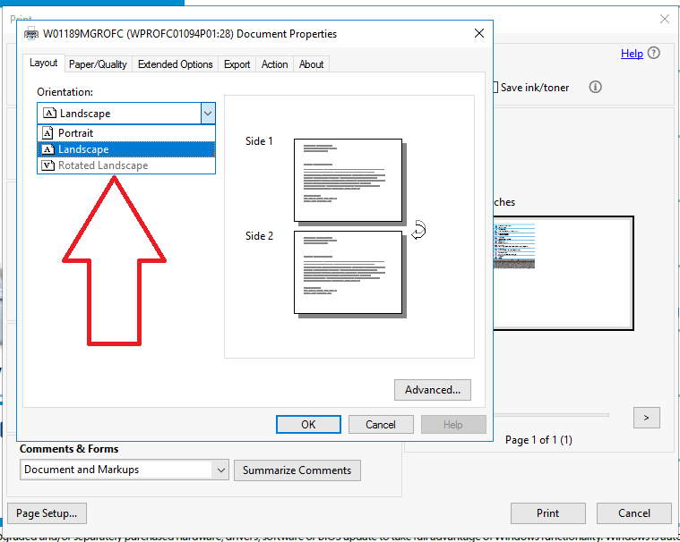
Step 6
The window will open up to the “Layout” tab at the top first.
Here we will set the Orientation once more to “Landscape” as indicated by the red arrow.

Slide 9
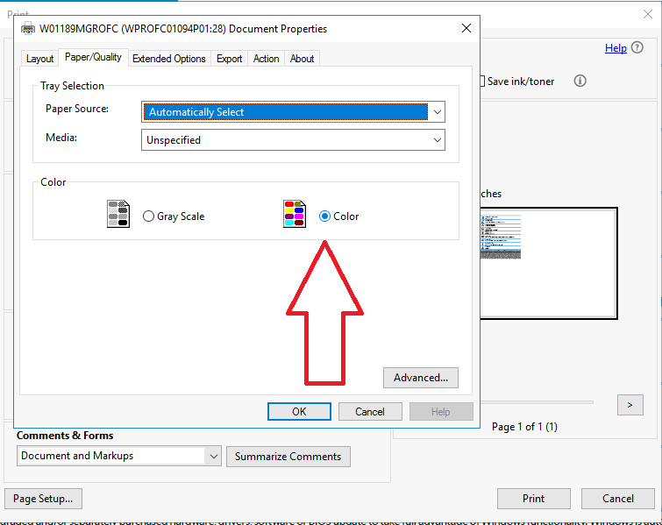
Step 7
Next, we will click on the “Paper/Quality” tab at the top of the window
Here we will click that we want the “color” option to be in “color” as indicated by the red arrow
Lastly, we will click on the “Advanced” button at the bottom of the window to choose the paper size

Slide 10
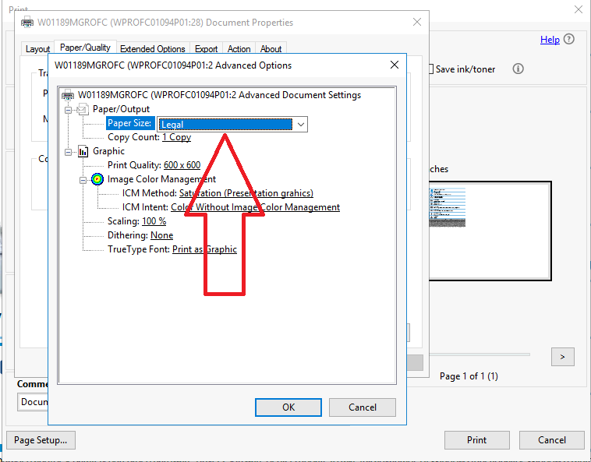
Step 8
In the Advanced options window, click the dropdown next to “Paper Size” as indicated by the red arrow and select “Legal” as the option.
Once completed click “ok”, and then click “ok” again in the Document Properties window to return to the main print menu

Slide 11
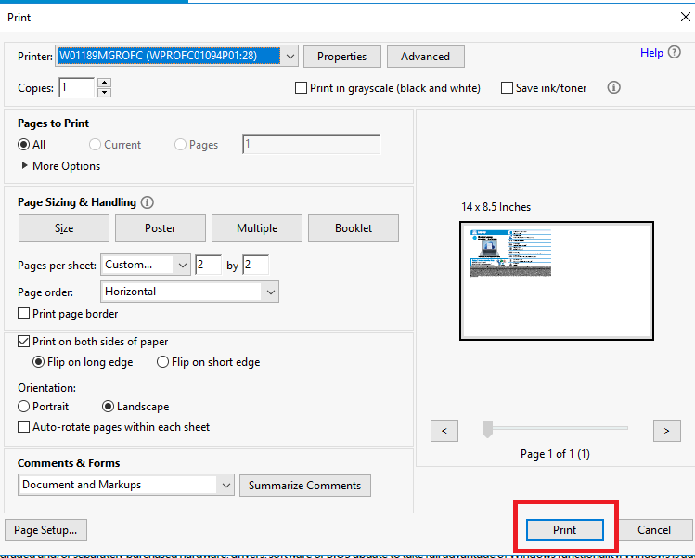
Step 9
Finally, select the print option at the bottom of the window.
The fact tag in question should print out on the perforated paper in the Manager’s office in color.

